Slide 1
Introduction to Artificial Intelligence
According to Gartner, 37% of firms have used AI in some form. Over the last four years, the ratio of businesses using AI has increased by 270%. It is becoming vital in new ways, from anticipating customer behavior to decreasing data entry.
This is not surprising that the future of Artificial Intelligence is promising as AI allows you to make judgments faster and more precisely than ever before. And while employing it is a fairly new technology, it already has a wide range of applications. This blog will look at the best contemporary applications of Artificial Intelligence in business.

Slide 2
Artificial Intelligence in Business
Large and small businesses rapidly understand the need to integrate AI to meet immediate and long-term objectives. Artificial Intelligence in business has the potential to redefine infrastructure significantly.
AI can automate many operational chores, freeing up corporate executives to handle more complex business challenges and decision-making.
AI technology can handle tasks such as data analysis that take human workers several hours to complete in seconds, allowing organizations to save greatly on salaries while increasing revenue.
Human failings are a fact. While people are required to provide context and comprehend intricate circumstances, data science benefits from less inaccuracy, enabling more accurate estimates and data analytics.

Slide 3
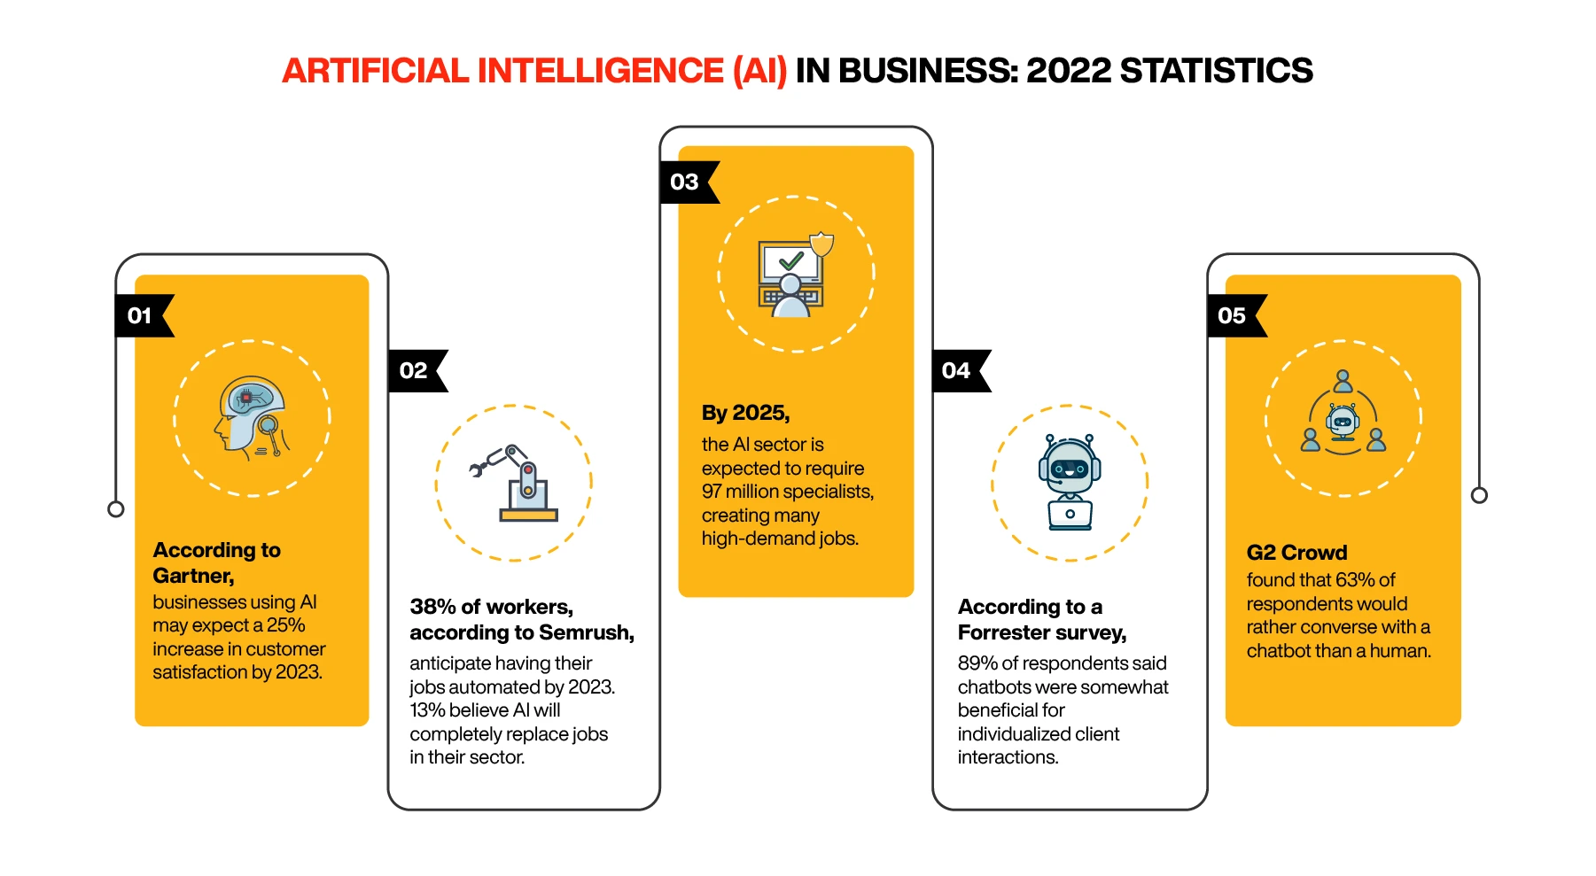

Slide 4
Applications of AI in Business Operations
Artificial Intelligence in business has yielded fantastic benefits for those open to exploring the utility of emerging technologies as business tools. The effects said AI capabilities are wide-ranging and expanding, meaning that the future of Artificial Intelligence is bright and will continue to evolve, benefiting businesses in new and exciting ways

Slide 5
AI for Business Strategy
When it comes to strategizing business, ML and AI are forever changing the landscape. Rather than relying on this year’s prediction exclusively on the previous year’s sales, Factors such as Regulations, seasonal demands, changes in the supply chain, unpredictable weather changes, trends, potential staffing issues, and much more impact businesses. Using Artificial Intelligence in business can strategize the approaches while keeping in mind these factors.

Slide 6
AI for Applications in Marketing and E-Commerce
AI-powered marketing uses customer information and Artificial Intelligence to predict the user’s buying patterns and propose customized ideas. At the same time, AI has cut R&D time and burden off marketers by outsourcing to machines.

Slide 7
AI for Business Operations
AI systems have a lot to offer organizations to optimize different processes, such as automating repetitive tasks, eliminating human error, and making human employment more productive. The best aspect is that technologies are getting inexpensive. So, if you haven’t already started implementing AI in your organization, now is the time.

Slide 8
Examples of AI applications in Business
1. Smart Assistants
Undoubtedly, this is a category you are familiar with when it comes to Artificial Intelligence. Siri, Cortana, Alexa, and Google Assistant are the most prominent smart assistants on the market today; they provide a variety of abilities and services that allow you to use your voice to:
Manage smart home devices and technologies
Look for information on the internet.
Call people and send SMS messages
Create reminders — and much more.

Slide 9
2. Helpdesk chatbots
A chatbot is computer software that is programmed to mimic human speech. It is vital to emphasize that the chatbot run by the interaction simulates a real-life discussion. Users engage via a chat interface or speech, and chatbots decipher the words and respond with a pre-programmed answer.
Chatbots are classified into three types:
Rule-based
Intelligence
AI-powered

Slide 10
3. Facial Recognition Technology
The program recognizes facial landmarks, making your facial signature a mathematical formula compared to a database of known faces.
Many companies employ facial recognition for several purposes, including:
At airports, the United States government
Law enforcement
Marketers and advertisers
Social media companies

